Slide 1

Objects

Slide 2
Recap
Map
Filter

Slide 3
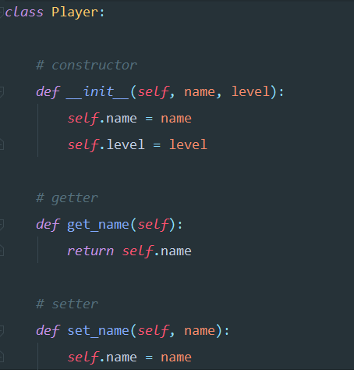
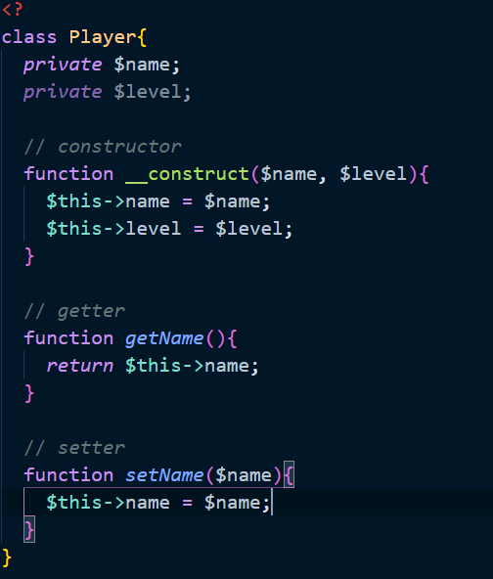
Example

Slide 4
Example
$this becomes self

Slide 5
Example
Self will be passed in each
method

Slide 6

Example
We can create an object
like this.

Slide 7

Example

Slide 8
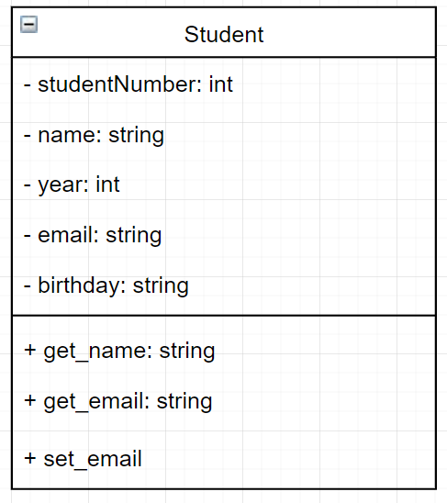
Exercise
Create the class in Python

Slide 9
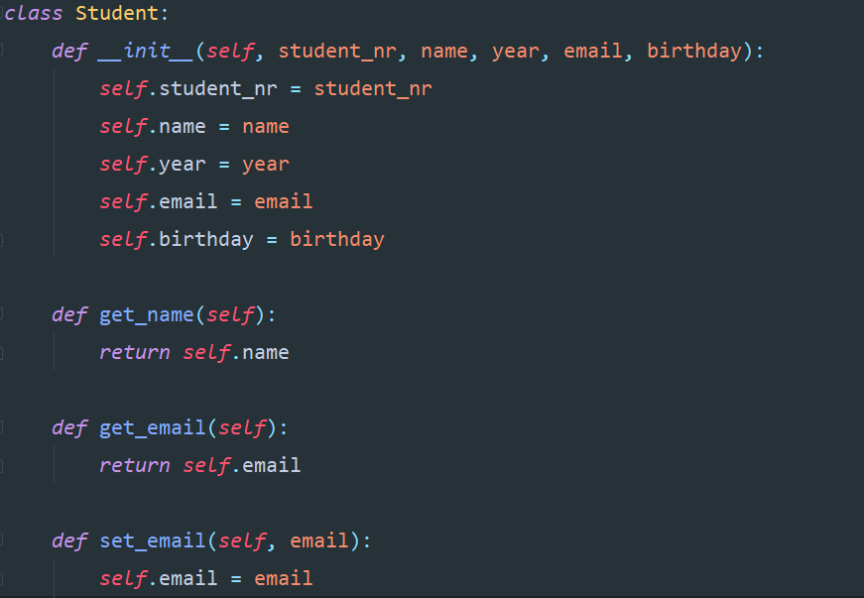
Exercise

Slide 10

Example
Is there a functional difference with this?

Slide 11
Example
private
public
The double underscore makes it private.
In methods aswell as variables

Slide 12
Exercise
Extend your code with the private values

Slide 13
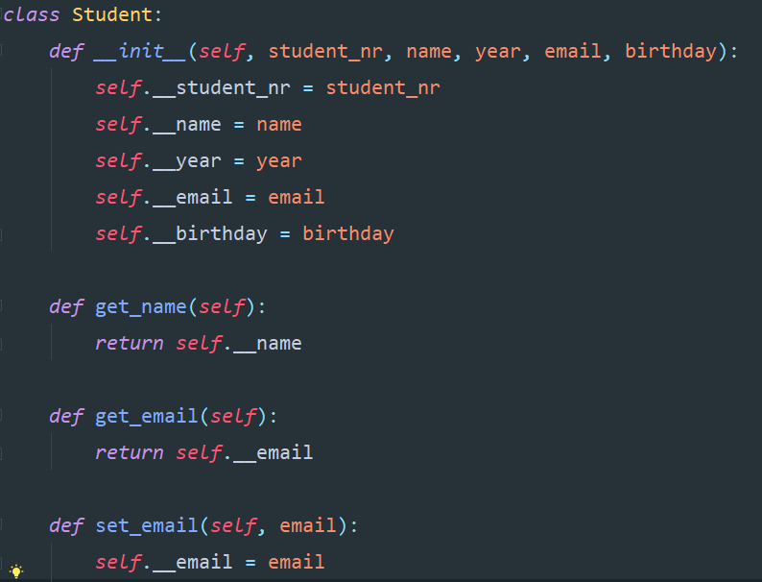
Exercise

Slide 14
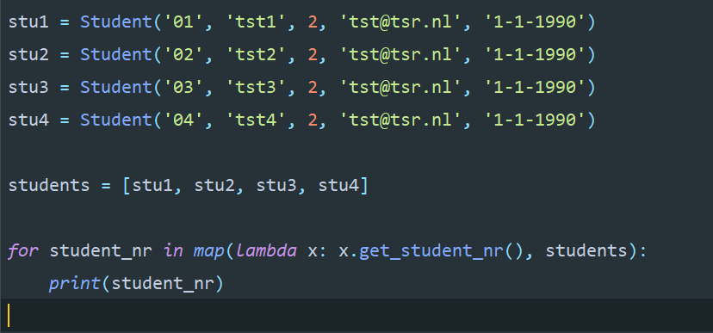
Example
What will this do?

Slide 15
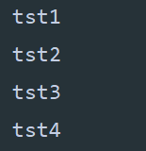
Example

Slide 16
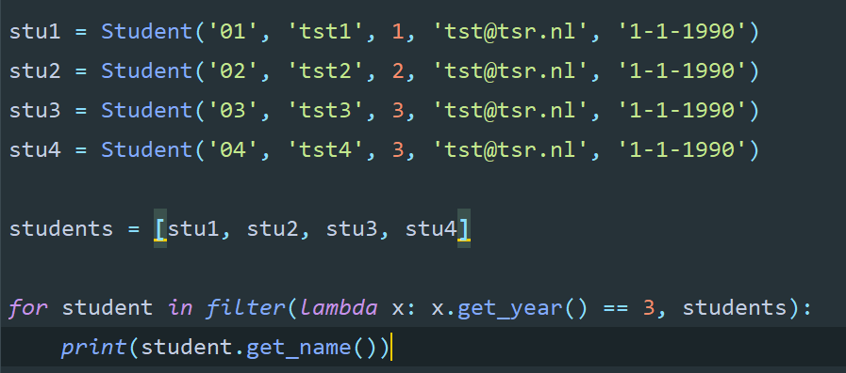
Example
What will this do?

Slide 17
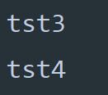
Example

Slide 18
Summary
Introduction to objects
Private in Python
Objects with map and filter

